Slide 1
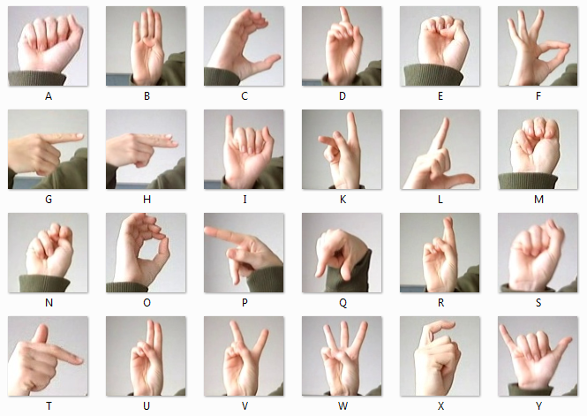
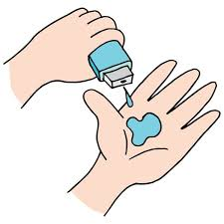
Team Name :UNNAMED CREW
Final Project:
American Sign Language Detection
GOKUL HARI R
KNOWLEDGE INSTITUTE OF TECHNOLOGY
Email id: 2k20cse048@kiot.ac.in

Slide 2
AMERICAN SIGN LANGUAGE RECOGNITION
We as normal people get to enjoy our day-to-day life without facing any difficulties in the mere activities. But there are people with disabilities who face difficulty in doing their daily needs.
Especially deaf and dumb people are the humans at the deepest psychological level. Education is very important for deaf and dumb students for their academic growth as well as for the development of their all-round personality.
But these impaired children lack the ability to use language and communication skills for educational purposes like their normal peers.
The main objective of this project is to help deaf and dumb people by removing communication barrier so that they are not restricted in a small social circle and are able to convey their feelings and emotions whenever they want.

Slide 3
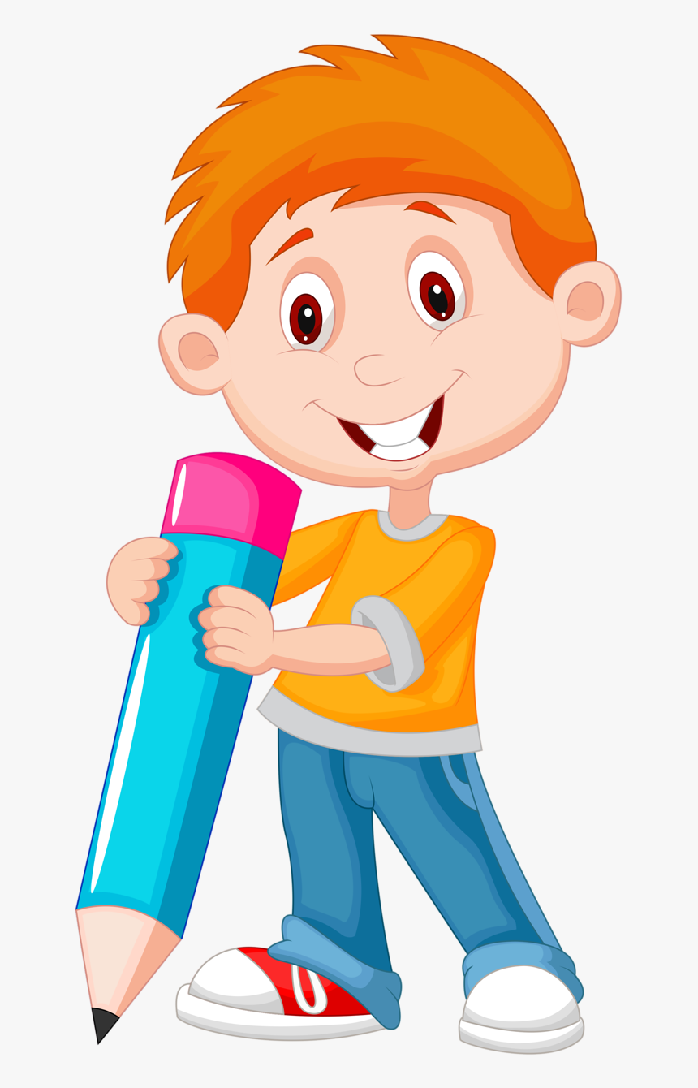
AGENDA
PROBLEM STATEMENT
PROJECT OVERVIEW
WHO ARE THE END USERS?
YOUR SOLUTION AND ITS VALUE PROPOSITION
THE WOW IN YOUR SOLUTION
MODELLING
RESULTS
MEET OUR TEAM

Slide 4

PROBLEM STATEMENT
To create a machine learning model that will be able to recognize the hand signs from images in the American Sign Language format.
To find a dataset having sufficient images following the ASL format.
To study about Neural Networks and how it can be used.
To split the dataset into training and testing sets.
To learn about Transfer Learning.
To create a model which gives a good accuracy.
To test the model’s accuracy on unseen(test) data

Slide 5
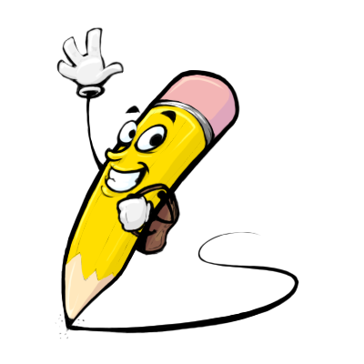
PROJECT OVERVIEW
To give a simple yet cost effective solution, a sign language translator to translate between sign language and text can be used, and this can be further upgraded to give output in form of speech and images.
A machine learning model is used to process the images of sign language in the form of hand gestures and give an output of what that particular gesture means in the form of text.
To train the model a dataset is required which can be obtained from kaggle, a free online data science repository and the data set is used to train a model using some packages available in python language.
Jupyter Notebook environment is used to train the model. and the model file can be used in various applications like apps, websites, embedded gadgets etc.

Slide 6

WHO ARE THE END USERS?
This model isn't restricted to any particular type of users. Anyone who wants to understand and communicate with a person who is deaf can use this and also dumb person can use that. It can be used by all who want to understand the American Sign Language.

Slide 7
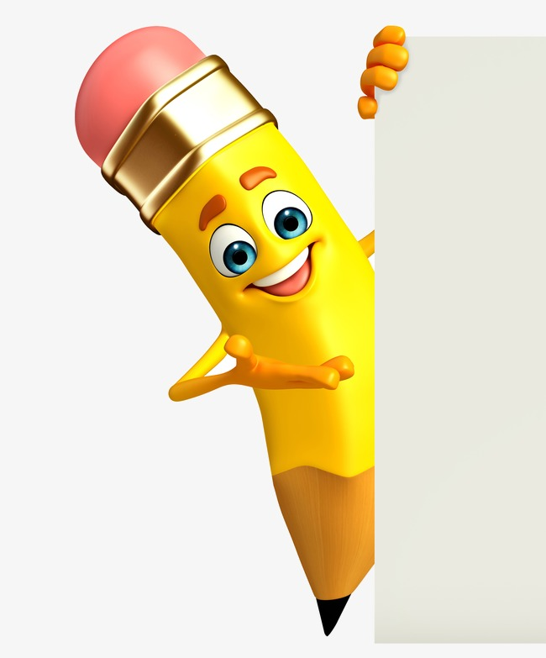
YOUR SOLUTION AND ITS VALUE PROPOSITION
My main idea here is to create a machine learning model which will recognize and predict the sign from the images and display it, so that the user will understand which alphabet or number is shown in the hand sign gesture. Hence people who have not learned ASL will be able to understand what the other person wants to convey.
I have decided to use InceptionV3 model using the methodology of Transfer Learning to create a model and train it on the ASL dataset obtained.

Slide 8
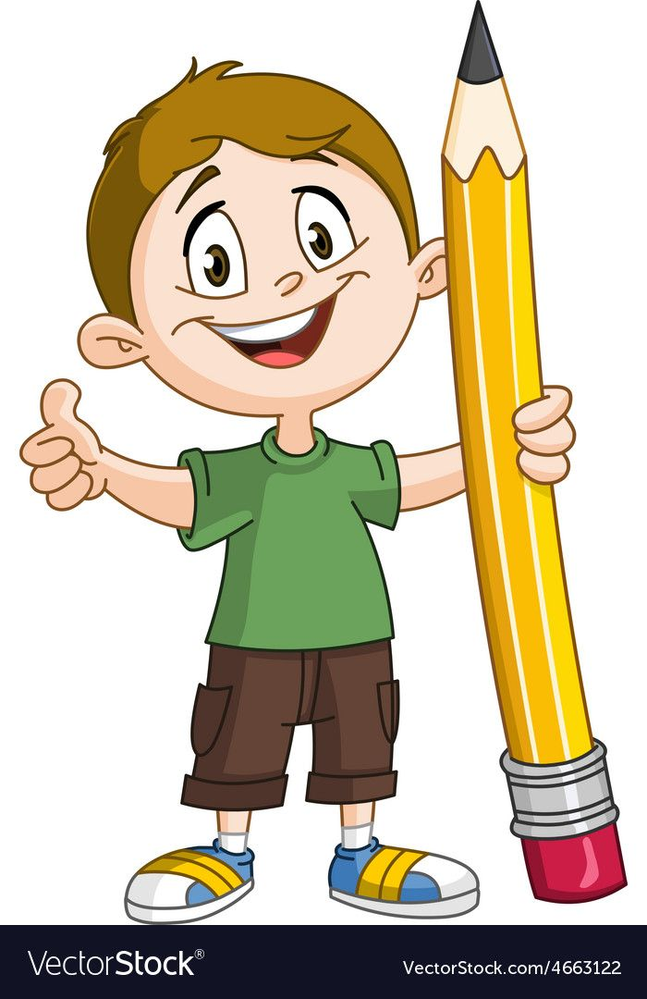
THE WOW IN YOUR SOLUTION
The trained model can be used to identify the sign language letters and numbers.
The model can be deployed in any application or a website to make it more user friendly.
The model can also be deployed in an embedded computer like raspberry pi etc...
The model is made using Transfer Learning.
Only a few extra layers were added and it was trained for just 32 epochs, still the model gives an accuracy of 93%.

Slide 9
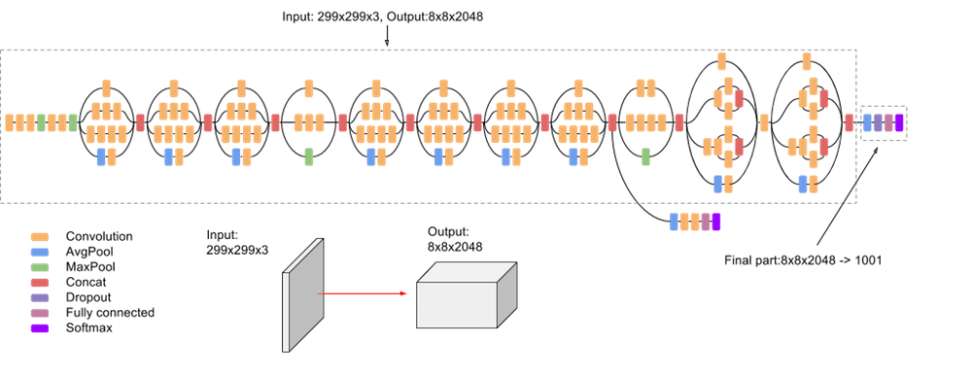
MODELLING : InceptionV3 Architecture

Slide 10
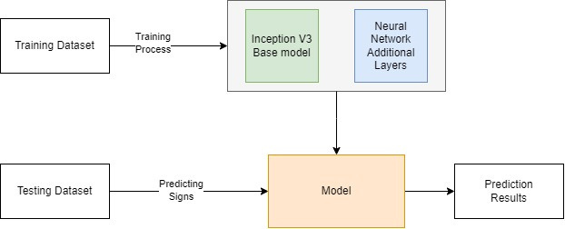
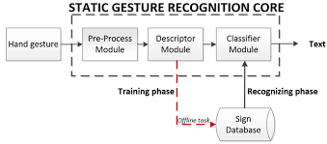
Block Diagram of the System
Flow Chart

Slide 11
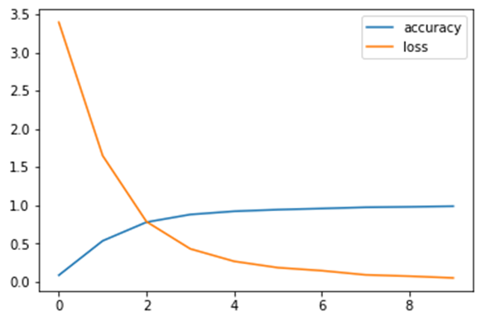
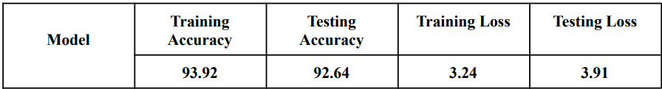
RESULTS
I have successfully created a machine learning model that can recognize the signs with an accuracy of 93.28% and with a loss rate of 3.57%. This accuracy is much better accuracy to recognize signs. The model can be improved. This model can predict the signs much accurately with image dataset and with a live video set.

Slide 12
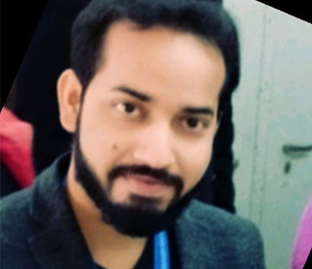
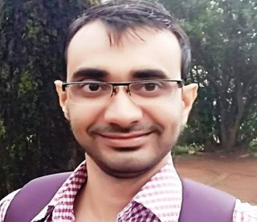
MEET OUR TEAM
Utkarsh Sharma [Mentor, Edunet Foundation]
.
.
Bassar Patel [Mentor, Edunet Foundation]

